Slide 1
Enhancing Data Integrity: A Fast-Fourier Lattice-based Compact Signatures Over NTRU (FALCON) Post-quantum Cryptography for Systems Data in the Provincial Government of Davao del Norte
Emmanuel H. Otacan
Notes:
Today, we assume that If your data escapes, as long as it’s encrypted, it’s no problem.
Because if someone gets the data, they still can’t read it.
But imagine a case where if you could jump into a time machine and go a hundred years into the future and bring one of the future computer with all it’s capabilities and use it to crack today’s crypto systems? Well, guess what, they would fall. In fact, nothing would be secret anymore.
1. Privacy would go out the window.
2. Transactions would no longer be reliable
3. And records couldn’t be trusted
Well, that’s the threat that we are facing with quantum cracking of crypto algorithms.

Slide 2
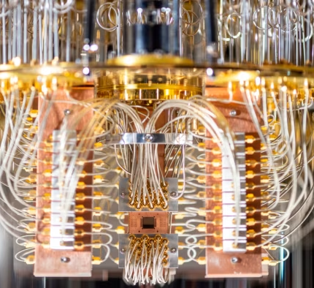
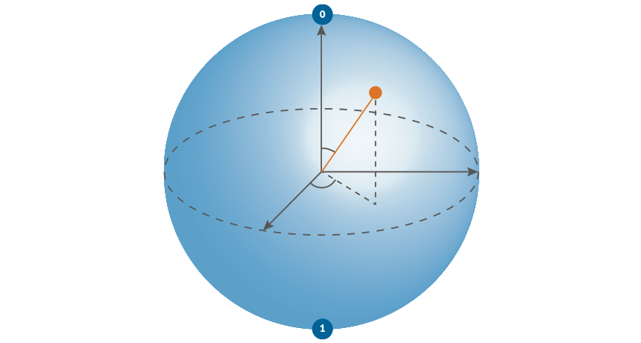
Introduction
“In the ever-evolving landscape of cybersecurity, a looming shadow emerges in the form of quantum computing, a technological force capable of unraveling the very fabric of modern cryptography's security.” [1][2][3][4]
Notes:
When sharing information, it is crucial to prioritize implementing security measures. The fast improvement of information technology today has made it convenient for individuals to exchange data or information easily [5]. Addressing security issues in these choices and implementations is essential, especially because big data environments lack comprehensive data protection features, making them low-hanging fruits for attackers. Large amounts of data stored on the cloud are very sensitive [6]

Slide 3
Why is this a problem and what’s the nature of the problem?
Symmetric
Asymmetric
21
=7x3
62, 615, 533
=7907 x 7919
Uses 1 key
Encrypt and decrypt with the same key
AES encryption standard
128-256 bits in length
Grover’s algorithm
2x the length
Uses 2 keys
Public and private keys
RSA algorithm
1024 – 2048 bits in length
Sho’r algorithm
??? algorithm
Notes:
So let’s take a look at not only the threat. but why is this a problem and what’s the nature of the problem?
We’ll fist of all, as you may be aware, there are different types of crypto algorithms. Symmetric and Asymmetric algorithm
--next next tapos discuss up to length of asymmetric algo.
Now, just an aside, why does this stuff work?
These algorithms are strong because they rely on mathematical problems that are hard to solve
One of those is factorization.
I’ll give you a taste of whats involved mathematically.
For example:
21 tell me what is the prime factor of 21?
7 x 3 – not so hard to figure out
but what if I give you a number like this 62, 615, 533
now tell me what are the two large prime factors of this?
- much more difficult to determine.
it is 7907 x 7919
Symmetric key length becomes half as strong because of the thing called Grover’s algorithm.
Grover’s algo. Weakens symmetric algorithm by half
- The good news is, if we go ahead and overcome the cracking capabilities of the quantum computer, all I have to do is just make the key twice as long. That’s not hard problem to solve.
The thing we’re much more worried about is the cases with asymmetric algorithm.
- Even though we have really long keys, it turns out that this algorithm will fall against the thing called the Shor’s algorithm.
- Shor’s algo is optimized for a quantum computer to work.
- A traditional computer can’t do nearly as much with that
??? So what we need here is a new crypto algorithm that is quantum safe
The good news is we have some of those now.

Slide 4
Why do we care about this?
1/7 by the year 2026
1/2 by the year 2031
~5 to 10 years
“Harvest the data now, and decrypt later”
Quantum Safe Cryptography
National Institute of Standards and Technology (4 quantum-safe algorithm)
Crystals-kyber, Crystals-dilithium, FALCON and SPHINCS+
Notes:
Cryto experts says that there is:
1/7 chance that by the year 2026 – well able to break these symmetric algorithms with Shor’s algorithm using a quantum computer that has enough qubits.
Further, the numbers look like 1/2 by the year 2031
If we look these projections, it is not so far off into the future.
If we say, Maybe ~5 to 10 years we’ll be okay. You might say “Emman, why do you care?”.
Wake me up in 5 to 10 years when this quantum computer is strong enough to break all of this.
And I’m going to tell you, we should care now! Because, remember the time machine example in the beginning of my presentation? That’s what going to happen.
We have this kind of attack where we “Harvest the data now, and decrypt later”.
What if I install a Data sniffer into your computer to get all your data even if it is encrypted?
What if I get a copy of your encrypted database?
And crack all of this using a quantum computer? If this happens, all of these records will be publicly available that becomes a huge problem for us.
So the time to start thinking about the problem is in fact now.
So we have kind of a response for this problem. QSC – Quantum Safe Cryptography.
These are the new set of algorithm that is not vulnerable to Shor’s Algorithm.
NIST and "The Collective“
Initiate a 6-year competition among a set of post-quantum cryptography algorithm
- 4 selected algorithm designed to withstand quantum computing
CRYSTALS-KYBER, CRYSTALS-DILITHIUM, FALCON and SPHINCS+
Superposition:
Definition: A quantum phenomenon that allows a qubit to exist in multiple states at the same time. This property is a fundamental difference from classical bits, which can only be in one state at a time.
Entanglement:
Definition: A quantum correlation between qubits that allows the state of one qubit to instantly influence the state of another, regardless of the physical distance between them. Entanglement is a key resource in quantum information processing.

Slide 5


Background of the Study
In the Provincial Government of Davao del Norte, there is a need for the adoption of cryptographical technologies including the advancement of the use of post-quantum cryptography.
Transactional systems in the organization encompass the 4 core systems. Executive Management System (EMIS), Financial Management Information System (FMIS), Properties and Supplies Information Management Systems (PASIMS), and the Human Resource Management Information System (HRIS). One of the problems encountered in the organization is the increasing data volume in their transactional systems. Every year, a large amount of data is generated by these systems. The proposed solution for the expansion of data is the implementation and application of data warehousing for permanent data. In line with this innovative solution, another problem arises which is the verification and validation of the data to be stored in the data warehouse.

Slide 6
Background of the Study cont.
This study proposes a solution for the verification, and validation of permanent data in preparation for the storage of data in the data warehouse by generating a hash digest of every record of the identified permanent data to be uploaded by the data owners which can be verified by solving the hashes in each record comparing it to the raw data of records. This work proposes the Fast-Fourier Lattice-based Compact Signatures Over NTRU (FALCON) to add a more secure feature that uses post-quantum cryptography in hashing the data.

Slide 7
General Objectives
This study aims to develop a Fast-Fourier Lattice-based Compact Signatures Over NTRU (FALCON) Post-quantum Cryptography for Systems Data in the Provincial Government of Davao del Norte.

Slide 8
Specific Objectives
Develop a web application to access the system's user interface.
Generate public and private FALCON keys that bind to every user’s identity.
Generate FALCON digital signatures using the user’s private key of identified permanent data or messages into the system.
Verify the authenticity of the data based on the user’s public key in comparison to the generated FALCON hash of records in the system.
View their authenticated/verified data in a dashboard.
Provide signatory and verification API access to other systems for system integration services.
Notes:
The web app will be developed with ASP.net framework
Public and private keys are generated via Python code implementation and then pass it through an API.
FALCON digital signatures are also generated in Python and access it through an API
Digital signatures and as well as the data will be verified also via API.
Users can view the authenticated data in the web app dashboard by temporarily uploading both the data and the signature. This will only work for general file signatures where users has the copy of the original file or data and its digital signature generated in the web application.

Slide 9
Significance of the Study
By providing a signature and verification mechanism for data warehousing, the organization can ensure the safe storage of sensitive information. Furthermore, the system's integration capabilities through an API and a user-friendly dashboard will empower the following specific end users:
Data Owners
Administrators and IT Personnel
External and Internal Auditors and Regulators
Citizens and the General Public
Researchers and Academics
Notes:
Data Owners - Data owners within the Provincial Government of Davao del Norte would be primary end users. They can verify the authenticity of identified permanent data/tables/records in the system, access the system through an API, view their uploaded data in a dashboard, and verify the authenticity of their data based on the generated hash of records.
2. Administrators and IT Personnel - IT personnel or administrators responsible for managing and maintaining the system would be end users as well. They would ensure the smooth operation of the system, manage user access, and oversee the technical aspects of the Fast-Fourier Lattice-based Compact Signatures Over NTRU (FALCON) Post-quantum Cryptography system
3. External and Internal Auditors and Regulators - External auditors and regulatory bodies, especially the Commission on Audit (COA), may use the system to verify the data integrity and security measures in place within the organization. This is especially relevant in the context of government organizations that need to comply with various regulations and standards.
4. Citizens and the General Public - The public or citizens may indirectly benefit from enhanced data integrity, as it can lead to more transparent and accountable government operations.
5. Researchers and Academics - Researchers and academics in the field of post-quantum cryptography, data security, and information technology may find the study significant for academic and research purposes. They can use the findings and methodologies for further research and education.

Slide 10
Definition of Terms
Discrete Fourier Transform (DFT) - is a mathematical transformation that transforms a sequence of complex numbers (or real numbers) into another sequence of complex numbers.
Fast Fourier Transform (FFT) - is an algorithm for efficiently computing the discrete Fourier transform (DFT) and its inverse. A mathematical algorithm that transforms a function of time (or space) into a function of frequency, is widely used in signal processing and cryptography.
Lattice - is a discrete set of points that spans a mathematical space in a regular, repeating pattern.
Hash Digest or Message Digest - Another term for the hash value produced by a cryptographic hash function. It is often used interchangeably with "hash value."

Slide 11
Definition of Terms cont.
Lattice-Based Cryptography - A cryptographic approach that relies on the mathematical structure of lattices, particularly resistant to attacks by quantum computers.
Compact Signatures - Efficient and concise representations of digital signatures, reducing the size of cryptographic signatures for improved efficiency.
N-th degree Truncated polynomial Ring Units (NTRU) - an open-source public-key cryptosystem that uses lattice-based cryptography to encrypt and decrypt data.
Fast-Fourier Lattice-based Compact Signatures Over NTRU (FALCON) - Falcon is a cryptographic signature algorithm submitted to the NIST Post-Quantum Cryptography Project on November 30th, 2017.

Slide 12
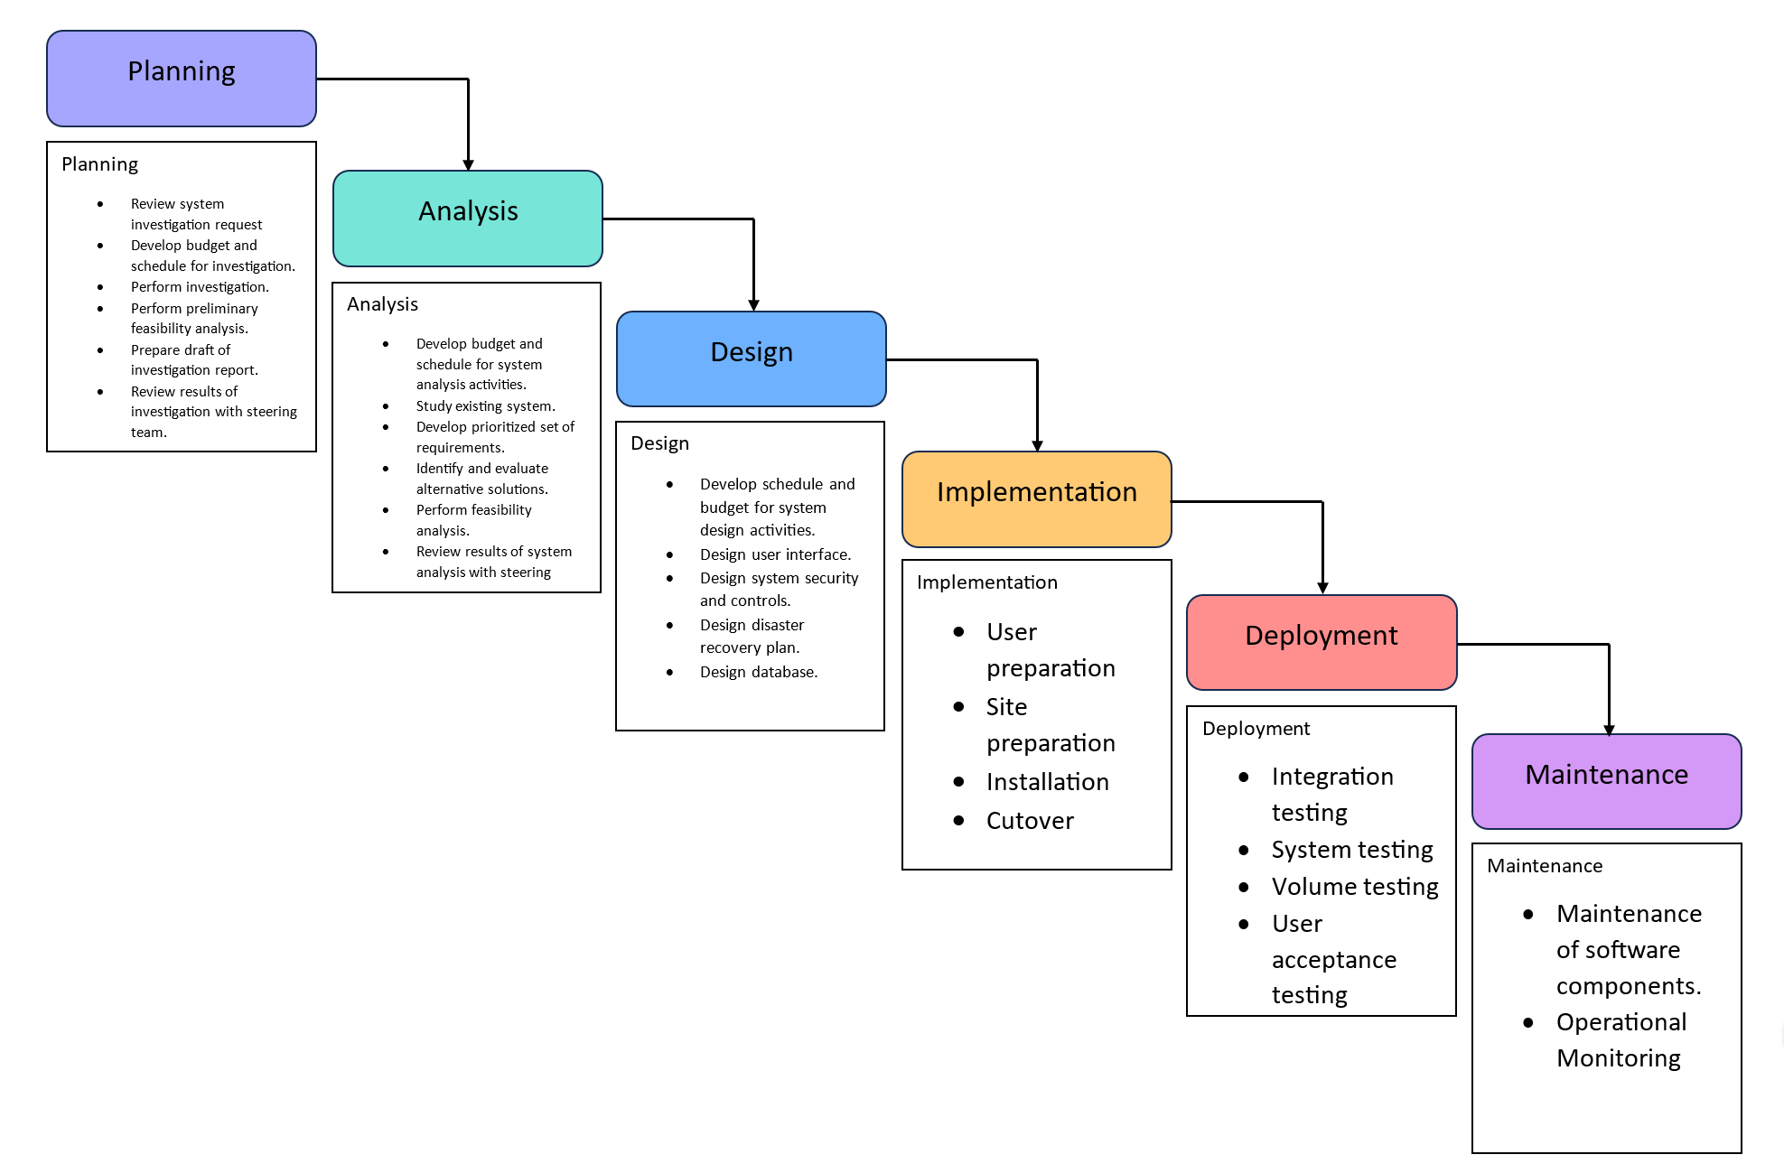
Methodology – Modified Waterfall Model

Slide 13
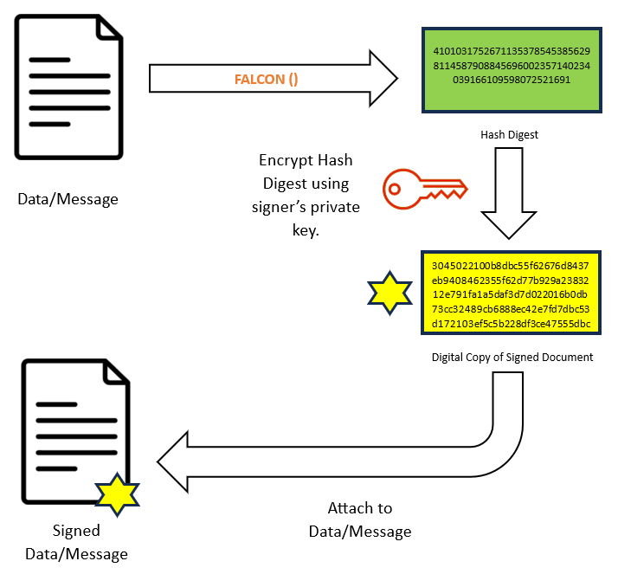
Digital Signature Attachment

Slide 14
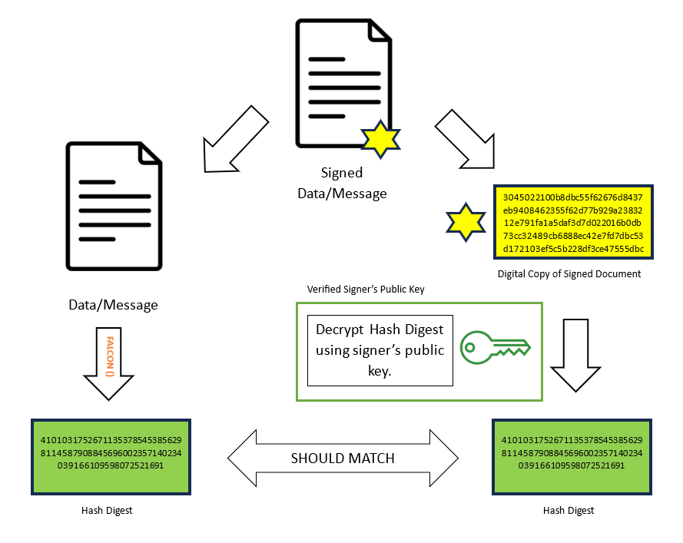
Digital Signature Verification

Slide 15

In the database context:

Slide 16
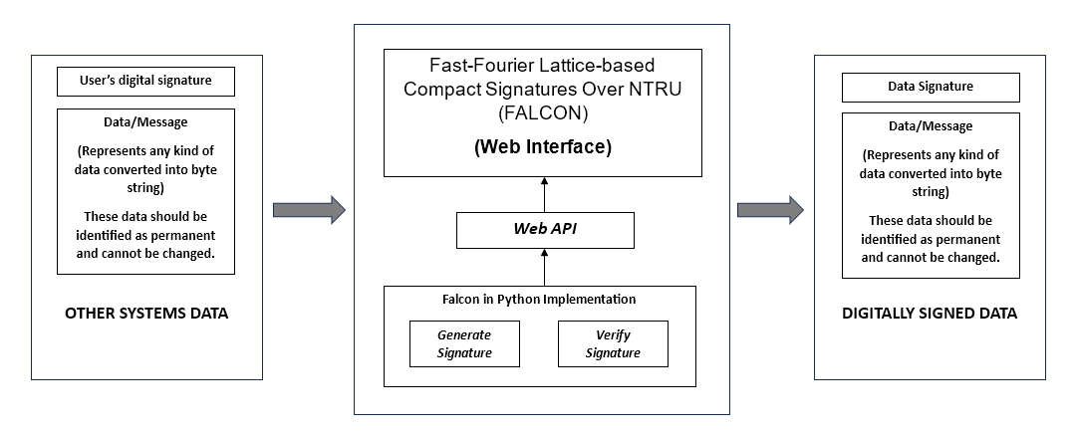
Conceptual Framework
Notes:
The initial step in the system process involves identifying the user's permanent data, which is then converted into a byte string. The user's digital signature, generated during the user registration process, is also associated with this data. Permanent data, which can encompass various types such as text, images, files, and records, serves as input for hash generation within the system. Users interact with the system through a web app interface, and upon uploading data, the web app triggers an API call for data signature generation. The API, in turn, produces a hash digest or data signature corresponding to the input data. Subsequently, this data signature is appended to the original data, serving to verify its authenticity. Users can validate the data either through the web application or by utilizing the web API.

Slide 17
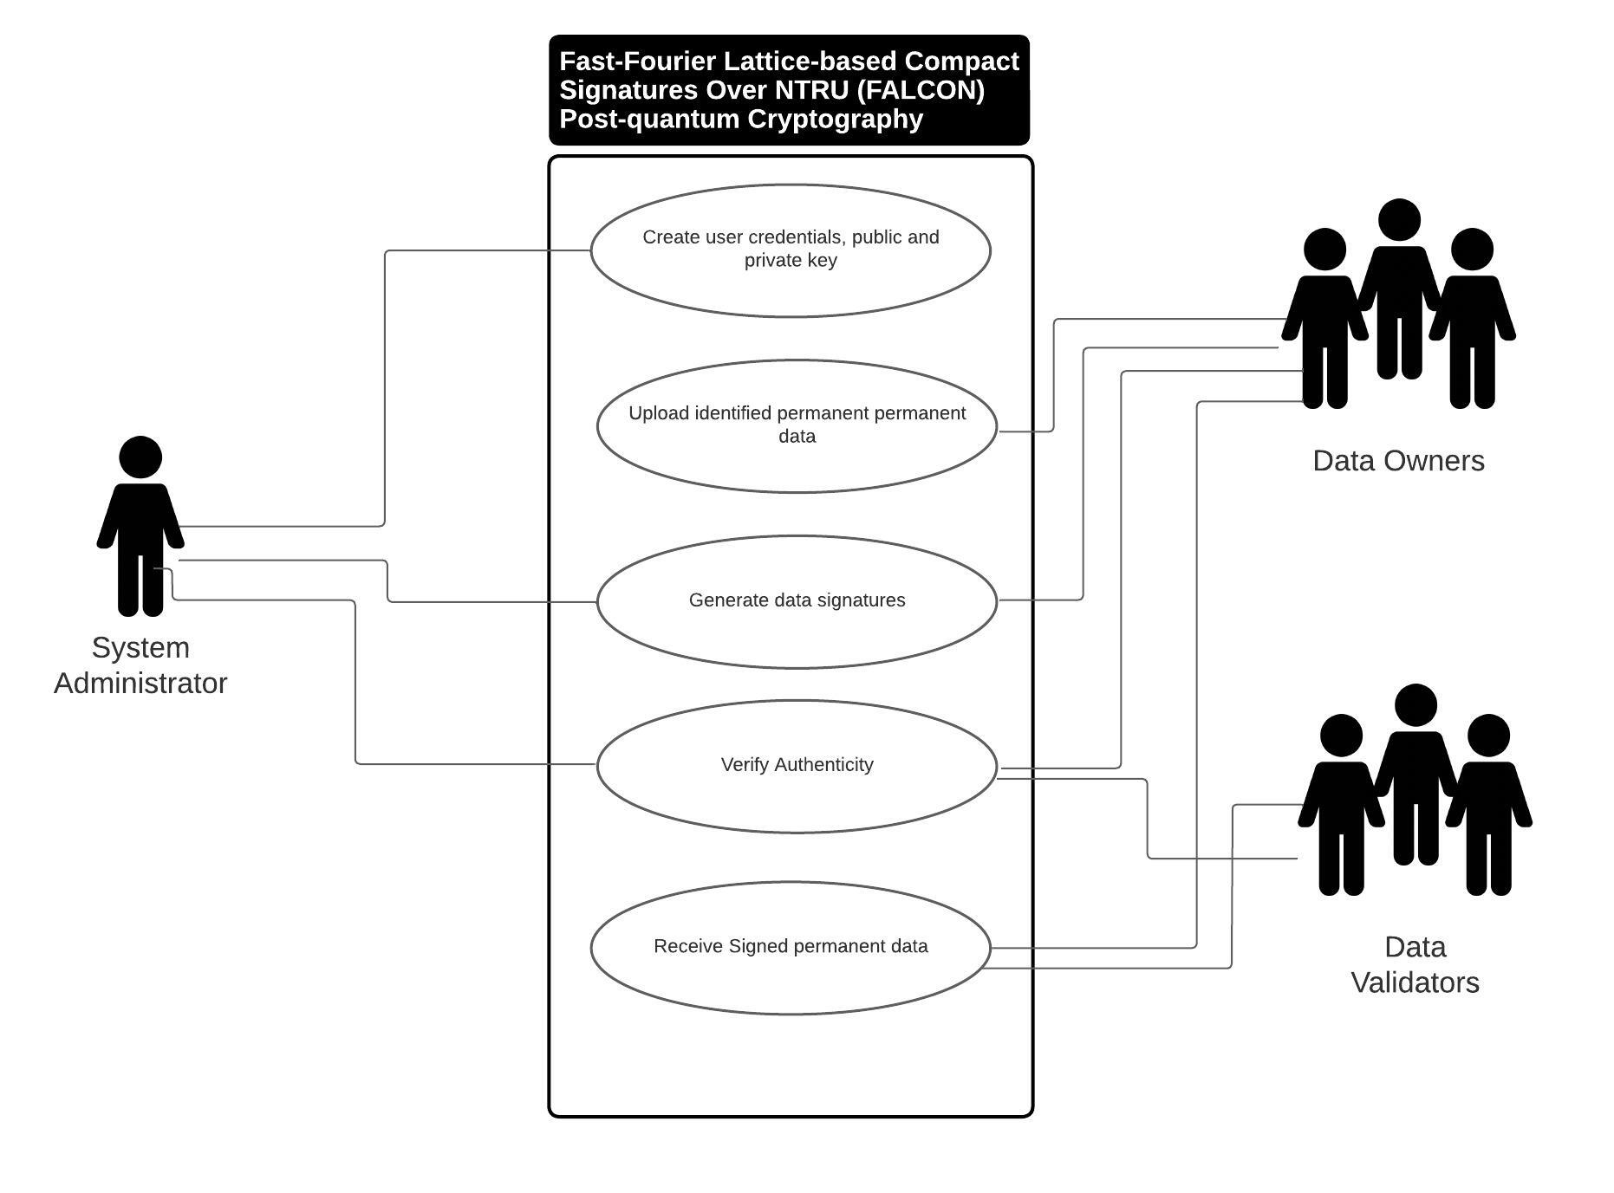
Use case diagram
Notes:
Three identified users have access to the major functionality of the system.
The system administrator is the one who is responsible for the creation of user credentials and the generation of the user’s public and private keys. After a user profile is created, users can now have access to the web application for them to upload their identified permanent data in the system.
The generation of data signatures can be done by both System Administrator and Data Owners.
The verification of the authenticity of data signatures can be done by the data owners themselves, the system administrator, and the data validators.

Slide 18
Technologies Applied
Fast-Fourier Lattice-based Compact Signatures Over NTRU (FALCON)
Falcon stands out as the most compact among all post-quantum signature schemes, showing an efficient and concise design that minimizes computational overhead. Not only does Falcon excel in compactness, but it also demonstrates commendable speed, making it a compelling choice for cryptographic applications that require both efficiency and security. Notably, the implementation of the signature component, referred to as Sign, introduces a delicate process involving Fast Fourier Sampling.

Slide 19

FALCON in a nutshell

Slide 20
Cyclotomic Ring
R = Z_{q}[x] / (x + 1)
Notes:
"R is equal to the quotient ring obtained by taking the polynomial ring over the finite field Zq​, denoted as Zq​[x], and modulo the ideal generated by the polynomial x+1.“
In simpler terms:
"R is the ring of polynomials with coefficients in the finite field Zq​, and we're considering equivalence classes of polynomials where two polynomials are considered equal if their difference is divisible by x+1."

Slide 21
Cyclotomic Ring
R = Z_{q}[x] / (x + 1)
Z_{q}: Denotes the finite field of order q. The elements in this field are integers modulo q. The field has q elements, where q is a prime power.
Notes:
Z_{q}: Denotes the finite field of order q. The elements in this field are integers modulo q. The field has q elements, where q is a prime power.
Z_{q}[x]: This is the polynomial ring over the finite field Z_{q}. It consists of polynomials whose coefficients are elements of Z_{q}.
(x + 1): Is an ideal in the polynomial ring Z_{q}[x]. The ideal generated by x + 1 consists of all polynomials that have x + 1 as a factor.
4. Z_{q}[x]/(x + 1): This represents the quotient ring obtained by dividing Z_{q}[x] by the ideal (x + 1). In other words, it's the set of equivalence classes of polynomials in Z_{q}[x], where two polynomials are considered equivalent if their difference is in the ideal (x + 1). This is also known as the quotient ring or residue class ring.

Slide 22
Cyclotomic Ring
R = Z_{q}[x] / (x + 1)
Z_{q}[x]: This is the polynomial ring over the finite field Z_{q}. It consists of polynomials whose coefficients are elements of Z_{q}.
Notes:
Z_{q}: Denotes the finite field of order q. The elements in this field are integers modulo q. The field has q elements, where q is a prime power.
Z_{q}[x]: This is the polynomial ring over the finite field Z_{q}. It consists of polynomials whose coefficients are elements of Z_{q}.
(x + 1): Is an ideal in the polynomial ring Z_{q}[x]. The ideal generated by x + 1 consists of all polynomials that have x + 1 as a factor.
4. Z_{q}[x]/(x + 1): This represents the quotient ring obtained by dividing Z_{q}[x] by the ideal (x + 1). In other words, it's the set of equivalence classes of polynomials in Z_{q}[x], where two polynomials are considered equivalent if their difference is in the ideal (x + 1). This is also known as the quotient ring or residue class ring.

Slide 23
Cyclotomic Ring
R = Z_{q}[x] / (x + 1)
(x + 1): Is an ideal in the polynomial ring Z_{q}[x]. The ideal generated by x + 1 consists of all polynomials that have x + 1 as a factor.
Notes:
Z_{q}: Denotes the finite field of order q. The elements in this field are integers modulo q. The field has q elements, where q is a prime power.
Z_{q}[x]: This is the polynomial ring over the finite field Z_{q}. It consists of polynomials whose coefficients are elements of Z_{q}.
(x + 1): Is an ideal in the polynomial ring Z_{q}[x]. The ideal generated by x + 1 consists of all polynomials that have x + 1 as a factor.
4. Z_{q}[x]/(x + 1): This represents the quotient ring obtained by dividing Z_{q}[x] by the ideal (x + 1). In other words, it's the set of equivalence classes of polynomials in Z_{q}[x], where two polynomials are considered equivalent if their difference is in the ideal (x + 1). This is also known as the quotient ring or residue class ring.

Slide 24
Cyclotomic Ring
R = Z_{q}[x] / (x + 1)
Z_{q}[x]/(x + 1): This represents the quotient ring obtained by dividing Z_{q}[x] by the ideal (x + 1). In other words, it's the set of equivalence classes of polynomials in Z_{q}[x], where two polynomials are considered equivalent if their difference is in the ideal (x + 1). This is also known as the quotient ring or residue class ring.
Notes:
Z_{q}: Denotes the finite field of order q. The elements in this field are integers modulo q. The field has q elements, where q is a prime power.
Z_{q}[x]: This is the polynomial ring over the finite field Z_{q}. It consists of polynomials whose coefficients are elements of Z_{q}.
(x + 1): Is an ideal in the polynomial ring Z_{q}[x]. The ideal generated by x + 1 consists of all polynomials that have x + 1 as a factor.
4. Z_{q}[x]/(x + 1): This represents the quotient ring obtained by dividing Z_{q}[x] by the ideal (x + 1). In other words, it's the set of equivalence classes of polynomials in Z_{q}[x], where two polynomials are considered equivalent if their difference is in the ideal (x + 1). This is also known as the quotient ring or residue class ring.

Slide 25
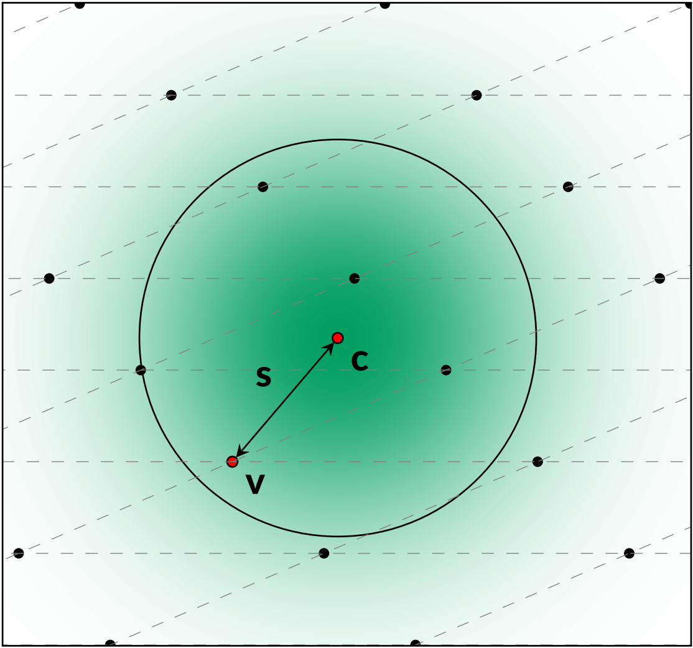
Cyclotomic Ring

Slide 26
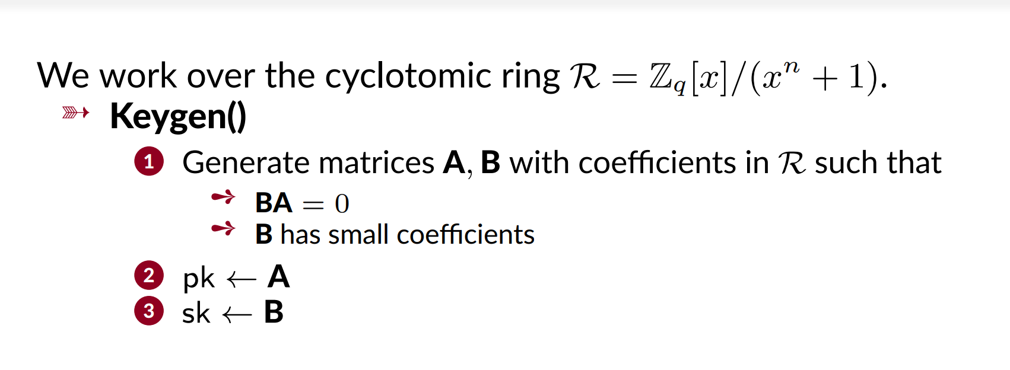
Key Generation Algorithm (Keygen())
Notes:
Step 1:
Generate Matrices A, B with Coefficients in R:
Two matrices, A and B, are generated. The coefficients of these matrices belong to the cyclotomic ring R. Additionally, the matrices are chosen in such a way that product B A results in the zero matrix. This property is often crucial for the security of cryptographic systems.
Note:
The condition B A = 0 implies that the rows of B are orthogonal to the columns of A, which is a common property in cryptographic schemes.
Note:
The use of matrices over the cyclotomic ring suggests a connection to lattice-based cryptography, where problems related to lattices are utilized for cryptographic security.
Additional Condition on Matrix B: The matrix B is specified to have small coefficients. This condition is likely related to the hardness assumptions or security properties of the Falcon.
Step 2:
Public Key (pk):
The public key (pk) is set to be matrix A.
Step 3:
Secret Key (sk):
The secret key (sk) is set to be matrix B.

Slide 27
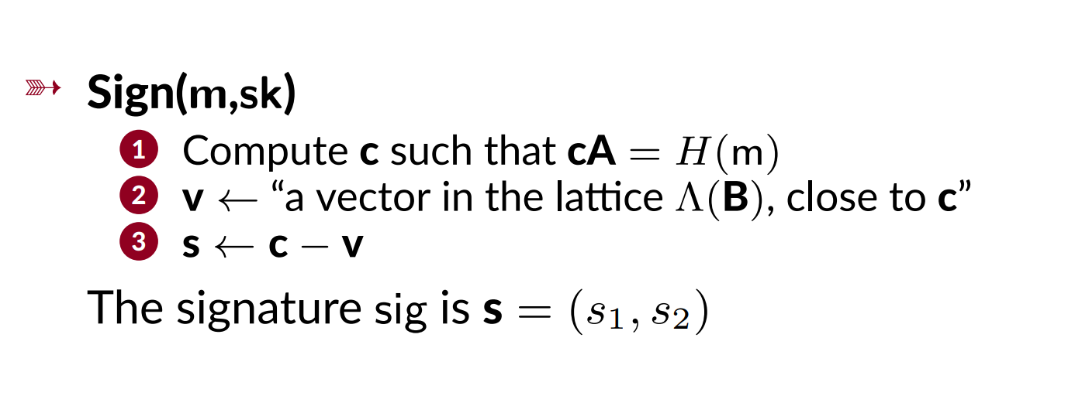
Signing a Message (m)
Notes:
Step 1:
Compute c such that cA = H(m):
Here, A is a matrix from the public key, and H(m) represents a hash of the message m. The goal is to find a vector c such that multiplying it by matrix A results in a value close to the hash of the message. This step is often related to the challenge-response mechanism used in digital signatures.
Step 2:
Select V ← "a vector in the lattice Λ(B), close to c":
This step involves selecting a vector (v from the lattice Λ(B), which is related to the secret key B in the public-key scheme. The vector v is chosen to be close to the computed vector c.
Lattice: In lattice-based cryptography, a lattice is a discrete set of points with a certain structure. The lattice Λ(B) is associated with the secret key matrix B.
Selecting v close to c: The choice of a vector v close to c is likely part of a mechanism to introduce randomness and enhance the security of the signature scheme. The closeness of v to c is a measure of how well the signer can hide the actual value of c.
Step 3:
Generate the signature s ←c−v:
The signature s is then computed as the difference between the vector c and the chosen vector v.
Interpretation: This subtraction is a way to blind the value of c, making it difficult for an adversary to recover c from the signature s. The resulting s is part of the signature for the message m.
The Signature s: The final signature is represented as a tuple s = (s1, s2), where s1​ and s2​ are components of the vector s.

Slide 28
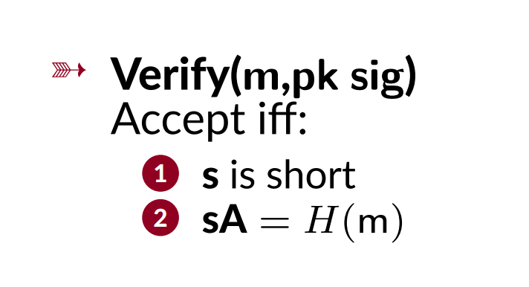
Verifying the message and the signature using the public key Verify (m, pk sig)
Notes:
Step 1:
Accept if s is short:
The length or size of the signature s should be relatively short. This condition is often desirable in practical applications as shorter signatures lead to more efficient communication and storage.
Short Signature Requirement: This requirement may be imposed to achieve efficiency in terms of bandwidth, storage, and computation. Short signatures are desirable for many practical applications, especially in resource-constrained environments.
Step 2:
Accept if sA = H(m):
Multiply the signature vector s by the public key matrix A, and the result should be equal to the hash of the message H(m). In other words, verify that the linear combination of the signature vector s and the public key matrix A corresponds to the hash of the message.
Linear Combination Verification: The equation sA=H(m) represents a key equation in the verification process. This equation ensures that the signature was generated using the private key corresponding to the given public key and that it corresponds to the hash of the message. The linear combination involving matrix multiplication is a common structure in cryptographic schemes, especially in lattice-based cryptography.
Rejection Criteria: If either of the conditions is not satisfied, the verification process should reject the signature. This rejection is important for ensuring the integrity and authenticity of the signed messages.

Slide 29
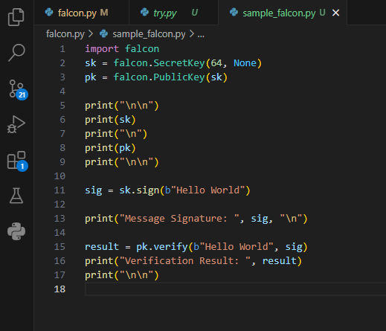
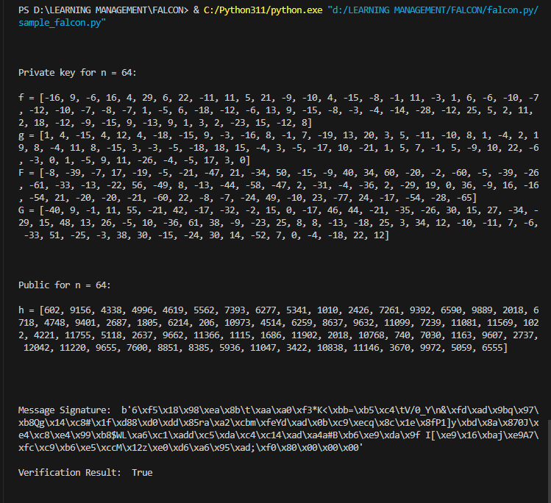
Code Demo

Slide 30
References
[1] V. Hassija et al., “Present landscape of quantum computing,” IET Quantum Communication, vol. 1, no. 2, pp. 42–48, Dec. 2020, doi: 10.1049/iet-qtc.2020.0027.
[2] “Zach Kirsch Quantum Computing: The Risk to Existing Encryption Methods”.
[3] W. Cui, T. Dou, and S. Yan, “Threats and Opportunities: Blockchain meets Quantum Computation,” in 2020 39th Chinese Control Conference (CCC), Jul. 2020. doi: 10.23919/ccc50068.2020.9189608.
[4] T. Niraula, A. Pokharel, A. Phuyal, P. Palikhel, and M. Pokharel, “Quantum Computers’ threat on Current Cryptographic Measures and Possible Solutions,” International Journal of Wireless and Microwave Technologies, vol. 12, no. 5, pp. 10–20, Oct. 2022, doi: 10.5815/ijwmt.2022.05.02.
[5] E. V. Haryannto, M. Zulfadly, Daifiria, M. B. Akbar, and I. Lazuly, “Implementation of Nihilist Cipher Algorithm in Securing Text Data With Md5 Verification,” Journal of Physics: Conference Series, vol. 1361, no. 1, p. 012020, Nov. 2019, doi: 10.1088/1742-6596/1361/1/012020.

Slide 31
References
[6] S. S. Moghadam and A. Fayoumi, “Toward Securing Cloud-Based Data Analytics: A Discussion on Current Solutions and Open Issues,” IEEE Access, vol. 7, pp. 45632–45650, 2019, doi: 10.1109/access.2019.2908761.
[7] S. S. Moghadam and A. Fayoumi, “Toward Securing Cloud-Based Data Analytics: A Discussion on Current Solutions and Open Issues,” IEEE Access, vol. 7, pp. 45632–45650, 2019, doi: 10.1109/access.2019.2908761.
[8] R. Sumithra and R. Parameswari, “Data privacy and data protection security algorithms for big data in cloud,” International journal of health sciences, pp. 7613–7621, May 2022, doi: 10.53730/ijhs.v6ns2.6834.
[9] L. Chen et al., “Report on Post-Quantum Cryptography,” National Institute of Standards, techreport, Apr. 2016. doi: 10.6028/nist.ir.8105.
[10] D. J. Bernstein and T. Lange, “Post-quantum cryptography,” Nature, vol. 549, no. 7671, pp. 188–194, Sep. 2017, doi: 10.1038/nature23461.
[11] M. Zhandry, “CRYPTOGRAPHY IN THE AGE OF QUANTUM COMPUTERS A DISSERTATION SUBMITTED TO THE DEPARTMENT OF COMPUTER SCIENCE AND THE COMMITTEE ON GRADUATE STUDIES OF STANFORD UNIVERSITY IN PARTIAL FULFILLMENT OF THE REQUIREMENTS FOR THE DEGREE OF DOCTOR OF PHILOSOPHY”.

Slide 32
References
[12] I. News, “QuSecure launches live end-to-end satellite quantum resilient link through space.” https://www.helpnetsecurity.com/2023/03/11/qusecure-quantum-resilient-cryptographic-communications-satellite-link/, p. 3, Mar. 10, 2023. [Online]. Available: https://www.helpnetsecurity.com/2023/03/11/qusecure-quantum-resilient-cryptographic-communications-satellite-link/
[13] “Google readies Chrome for distant quantum attacks with new support.” https://www.csoonline.com/article/649480/google-readies-chrome-for-distant-quantum-attacks-with-new-support.html, p. 1. [Online]. Available: https://www.csoonline.com/article/649480/google-readies-chrome-for-distant-quantum-attacks-with-new-support.html
[14] J. R. Jeffrey and Yasay, “The Dawn of Digital Coins: A Literature Review on Cryptocurrency in the Philippines”.
[15] J. R. Jeffrey and Yasay, “The Dawn of Digital Coins: A Literature Review on Cryptocurrency in the Philippines”.
[16] M. Ricci et al., “A Comprehensive Study on the Feasibility and Suitability of Bitcoin in the Philippine Setting”.
[17] F. M. Ablayev and A. V. Vasiliev, “Cryptographic quantum hashing,” Laser Physics Letters, vol. 11, no. 2, p. 025202, Dec. 2013, doi: 10.1088/1612-2011/11/2/025202.
[18] V. Mavroeidis, K. Vishi, M. D., and A. Jøsang, “The Impact of Quantum Computing on Present Cryptography,” International Journal of Advanced Computer Science and Applications, vol. 9, no. 3, 2018, doi: 10.14569/ijacsa.2018.090354.

Slide 33
References
[19] M. F. Sanner, “PYTHON: A PROGRAMMING LANGUAGE FOR SOFTWARE INTEGRATION AND DEVELOPMENT”.
[20] K. R. Srinath, “Python -The Fastest Growing Programming Language”.
[21] A. J. Dhruv, R. Patel, and N. Doshi, “Python: The Most Advanced Programming Language for Computer Science Applications,” in Proceedings of the International Conference on Culture Heritage, Education, Sustainable Tourism, and Innovation Technologies, 2020. doi: 10.5220/0010307902920299.
[22] W. Chansuwath and T. Senivongse, “A model-driven development of web applications using AngularJS framework,” in 2016 IEEE/ACIS 15th International Conference on Computer and Information Science (ICIS), Jun. 2016. doi: 10.1109/icis.2016.7550838.
[23] “Fourier Transforms and the Fast Fourier Transform (FFT) Algorithm”.
[24] P. Duhamel and M. Vetterli, “FAST FOURIER TRANSFORMS: A TUTORIAL REVIEW AND A STATE OF THE ART”.
[25] P.-A. Fouque et al., “Falcon: Fast-Fourier Lattice-based Compact Signatures over NTRU Specification v1.2 -01/10/2020”.

